Slide 1
Determining Magnetic Moment of Various Materials
By: William Poole

Slide 2
Magnetic moment
This unit relates energy to the current [Am^2 or J/T]
m=nIA->
# of turns [n]
Current amps [I]
Area [m^2 -> “normal vector”

Slide 3
Magnetization
M=dm/dv
M-field = the derivative of magnetic moment with respect to volume
B=u0(H+M)
B is B-field [Tesla -> kg/(A*s^2)]
H is H-field [A/M]
Uo is permeability [H/M -> N/A^2]
Kg/(A*s^2)=(N/A^2)*(A/M) | verified

Slide 4
How to Determine M-field
Magnetization Curve
This will use to generate an energy density of a material in terms of J/m^3
This will be complicated as B-field fluctuates constantly through the part and will result in changes to the resultant energy density of the material.
Then the change of this energy is the U=Dot(m->,B->)
Also of note Max energy product B*H=J/m^3

Slide 5
BH curves
To get the resultant energy density of a magnet there is evidently a lot to look at:
B and H which are equal to each other in B=uH
U=u_0*u_r, dB/dH gives u
This plot of a B-H curve showcases as H increases, B starts flattening
This is magnetic saturation
Note the material must follow this path, not be within this area
Though when the H-field is released it will fall to retentive point

Slide 6
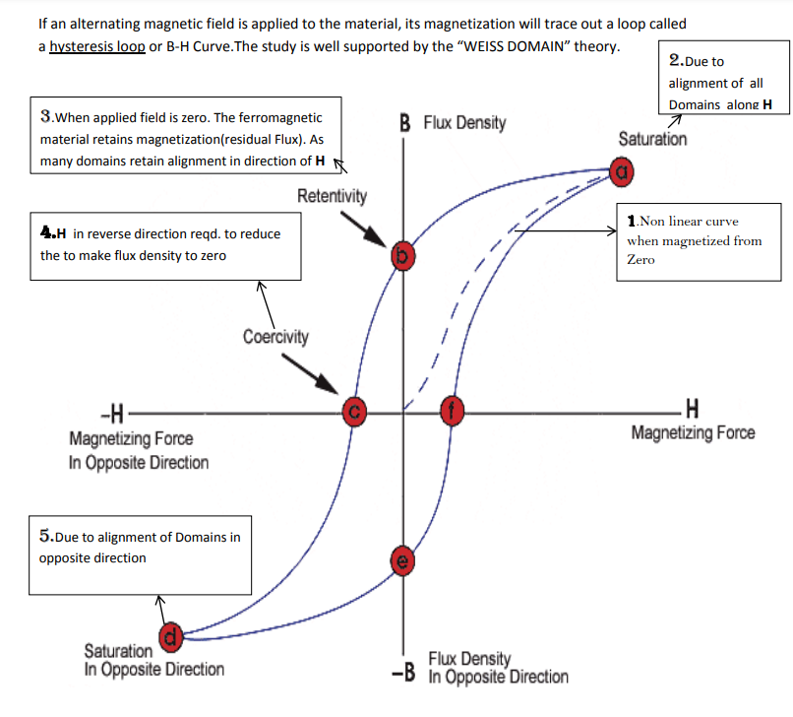
Source

Slide 7
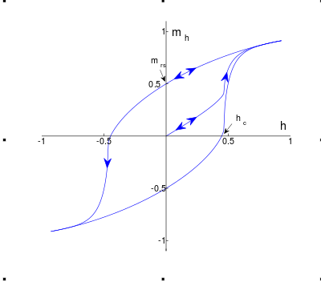
HM curves or Method to get Magnetization
As a reminder we want to calculate magnetization M as from that we can get magnetic moment. This will be useful in-case we want to deal with demagnetization effects or saturation of a material.
To get M we can also use
B=u0(H+M) Though, there must be a disconnect for the BH curve for the BH-curve, B=uH and then re-applied to get M

Slide 8
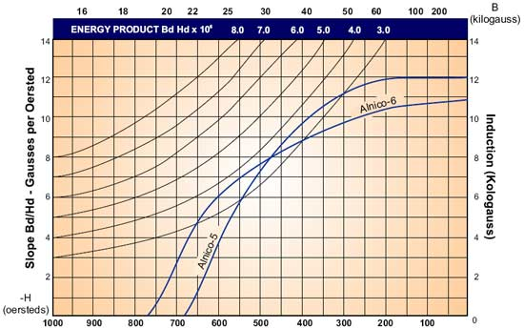
Picking a Material
I looked for a projectile to match a size of the picked barrel:
CA-0216
0.25” Diameter x 3.250” Alnico 5
According to its datasheet has this BH curve for demagnetization, intercept is residual [flat curve] {12kG=1.2T} |1.2T/u0=M|->954,929 A/M
MSM-228
8mm Diameter x 38mm Alnico 5
According to its datasheet it has a remanence B {Br} of 1190 mT. Resultant M would be |(0.1190T/u0)=M|->94,697 A/M

Slide 9
Sources
Magnetic moment
Maximum energy product
Tesla (unit)
Magnetization
Magnetic moment
Magnetic hysteresis

